Slide 1
Speech to 3D scene generation
Presented by:
Manthan Turakhia – 1624013
Umang Nandu – 1624016
Prayesh Shah -1624019
Siddharth Sharma - 1624020
Under The Guidance Of:
Prof. Sagar Korde

Slide 2
CONTENTS
Status Summary
Problem Definition
Speech to text module
Parts of speech tagging
Parse Tree
Attention areas
SRS
Software Design
SPMP
Test cases
Take away

Slide 3
Problem Definition
There is a stale in multiple industries with respect to the presentation of knowledge. In simpler words, ways of presenting and imparting knowledge, and creating architectural masterpieces have become mundane and monotonous. Therefore, to bring a change, we introduce a way to paint a picture with your words.

Slide 4
STATUS SUMMARY
Speech to text conversion
POS tagging
Parse tree generation
Database creation
Query generation
Rendering

Slide 5
Speech to Text
Google Speech to text API
Speech Recognition library by Anthony Zhang
Easy to tweak
Well handled exceptions
Fast and reliable
Input : User speaking into the microphone
Output : String text

Slide 6
Parts-Of-Speech tagging
Identify and tag the parts of speech
Store each lexical element along with its POS tags in json format
Input : String of text generated by the Speech-Recognition module
Output : JSON file

Slide 7
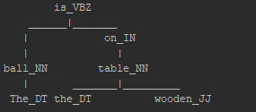
Parse tree
For example :
Consider sentence
“The ball is on the wooden table”

Slide 8
ATTENTION AREAS
Speed and Reliability
Speed and reliability were the major concerns during the planning of the project.
Making use of industry level/standard libraries is key.
However, it does not end here!.

Slide 9
SRS
FUNCTIONAL REQUIREMENTS:
1. Input Data requirements:
Speech Input.
JSON as an input data to Database and Rendering.
2. Operational requirements
Conversion of speech to text.
POS tagging.
Parse tree generation.
Information gathering and rendering.

Slide 10
SRS
NON-FUNCTIONAL REQUIREMENTS:
Performance: 75% conversion accuracy. Worst case 15s generation. Best case 3s.
Data Integrity: Data and modules to be kept abstract.
Usability: Smooth screen-to-screen movement.
SRS : srs.pdf

Slide 11
SDD
Speech to 3D Scene Generation
System Architecture
DFD Level 0
DFD Level 1
SDD : sdd.pdf

Slide 12
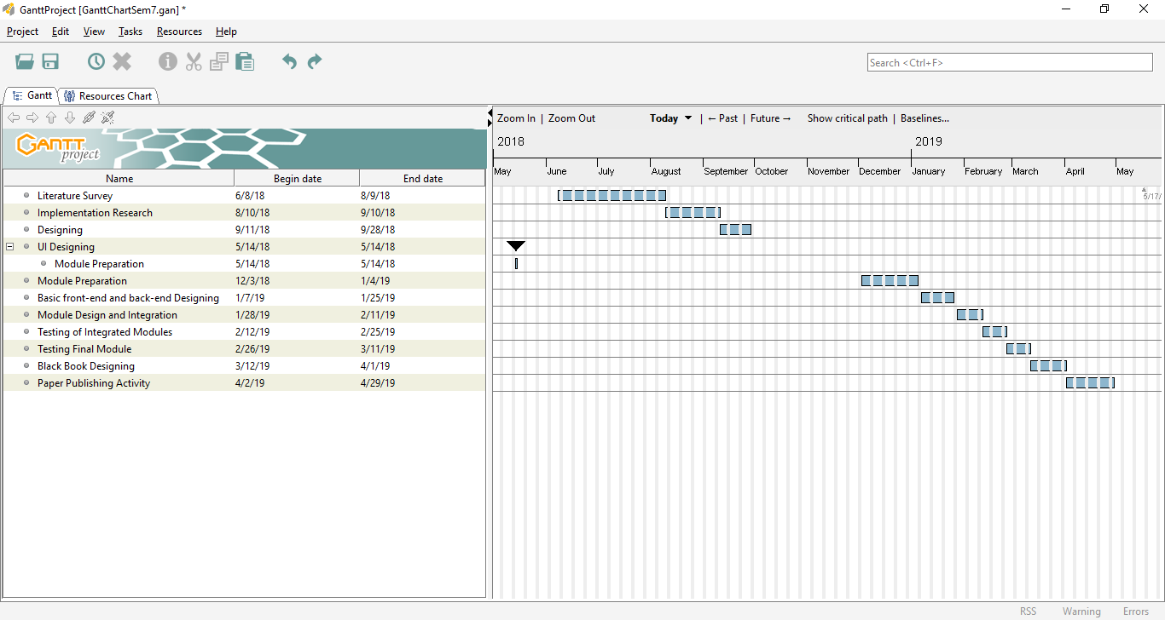
SPMP
Speech to 3D Scene Generation
Timeline

Slide 13
SPMP
Roles and Responsibilities:
Roles | Responsibilities
Team Leader | Manages all the task and schedules the deadlines.
Project Manager | Requirement gathering and coordination of various events.
Front End Developer | Development of user friendly user interface.
Back End Developer | Development and linking of various backend modules.
Tester | Tests all the modules using software testing tools and techniques.
SPMP : spmp.pdf

Slide 14
Test Cases
1 Test case: Speech to text conversion
Purpose: Whether the input speech converted into the text is valid for the further processing or not. To check how accurate, the speech is converted into text.
Input:- Voice Input
Expected Output: The text is valid if the text converted is same as the speech input given by the user. If it is then text is further processed else user can rerecord the input.
2 Test case: Tagging and Labelling
Purpose: To check whether the parts of speech tagging and labelling of the text is done meaningfully or not.
Input: Text Converted using Speech to text Recognition.
Expected Output: JSON or XML file which will contain proper parts of speech tagging and labelling of the text.

Slide 15
Test Cases
3 Test case: Rendered Models
Purpose: To check whether the rendered models from data warehouse are perfectly suitable with the input provided in first stage.
Input: No input from the user, the converted text is processed further.
Expected Output: Actual model of specific objects specified by the user are correctly rendered else final output will be incorrect, Models should not overlap.
4 Test case: Positions of the object (models)
Purpose: To check whether the models rendered and displayed on the output screen are at proper coordinates as user wants.
Input: No specific input, Text is processed.
STD : std.pdf

Slide 16
TAKE AWAY
The system, in its current state, is being able to convert user’s speech input to text output. This text output is provided to SpaCy which performs Parts Of Speech (POS) tagging and generates a JSON file. This JSON file is used to generate a Parse Tree.
The JSON file along with Parse Tree will be used later in the form of ‘Linguistic knowledge’ and ‘World knowledge’ to interpret the same and render a scene accordingly.
ANY QUESTIONS?

